Slide 1

PORTFOLIO SITE
Project Id: BT2040
Team Members Detail:
Sachin Chaudhary(20SCSE1280021)

Slide 2


ABOUT PORTFOLIO SITE
A portfolio website is the quickest and easiest way of showcasing your work as a designer. Even if you have a physical portfolio, a website is still an expected extra – and it's vital that it makes your work sing. Not everyone has the web design skills to be comfortable creating a website with a stunning, easy-to-use layout.

Slide 3
A portfolio site is an extension of a freelancer's (or company's) résumé. It provides a convenient way for potential clients to view our work while also allowing us to expand on our skills and services. ... We should decide what we want to accomplish with our website before adding content to it

Slide 4
REQUIREMENTS
This web application is software based and requires a lot of on going technologies in the build-up. The major need of this project was an API because this was the key part of this web application to with the help of which we were able to fetch the data from the server according the input of the user. Now let’s discuss about the technical part of this project. The foremost requirement was the integrated development environment(IDE).

Slide 5
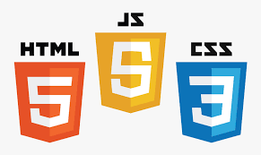
Next part was the languages and framework that has been used in doing this work. HTML: The Hyper Text Markup Language or HTML is the standard markup language that has been used in designing the basic layout of the page to be displayed on web browser. CSS: CSS or Cascading Style Sheets is the language that has been used in designing the HTML. The designing aspect of the application is fulfilled by this technology.

Slide 6

JavaScript: JS is simply the programming language of the Web which has been used in our project to give the logical flow to our web application. Like the user entered any product in the search box then it is the duty of fetch() function of JavaScript to fetch the required data from the API which itself consists of thousands of data. So basically it can be said that JavaScript is the major language that has been used in our project.

Slide 7
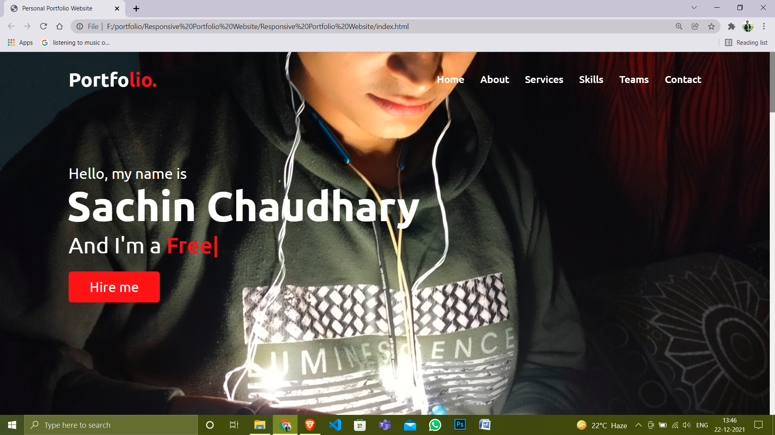
PROJECT OVERVIEW

Slide 8
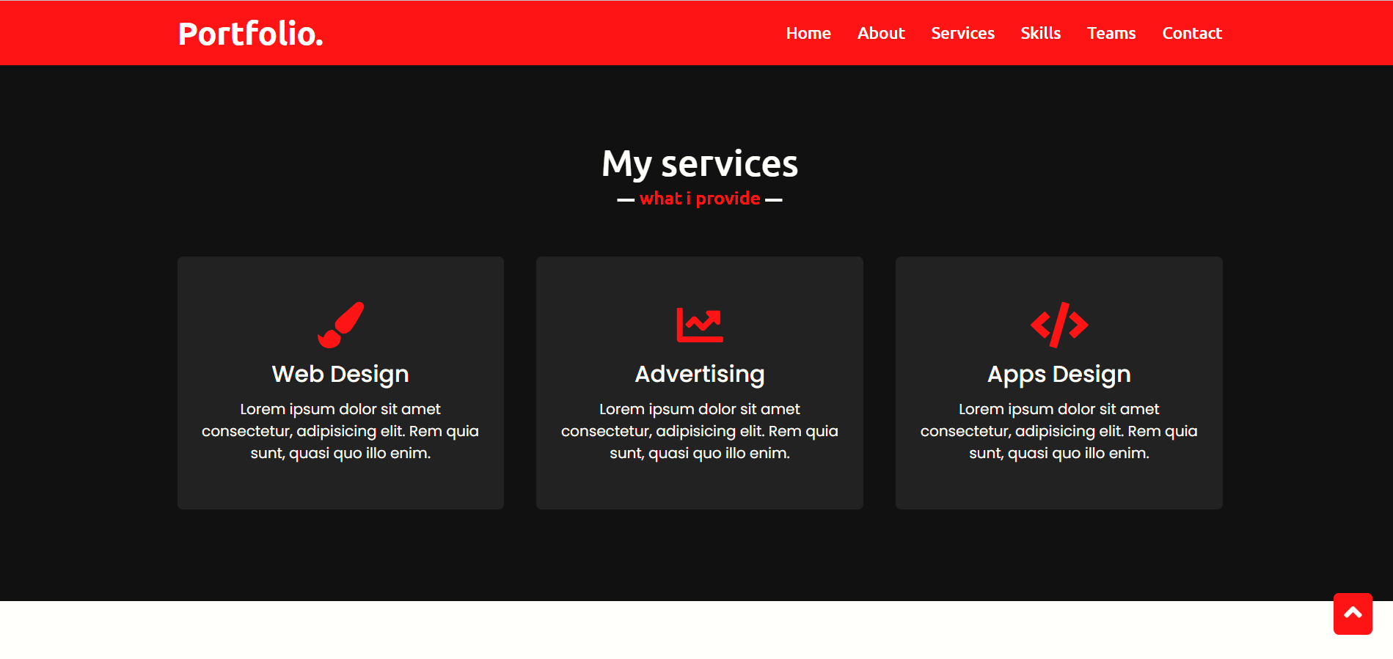
PRODUCT PAGE

Slide 9
CONCLUSION
Building an online portfolio can be a daunting task. But if we keep the purpose of a portfolio website in mind, the path to the finish line is a clearly guided process.

Slide 10


